Slide 1

@smileandeliver

Slide 2
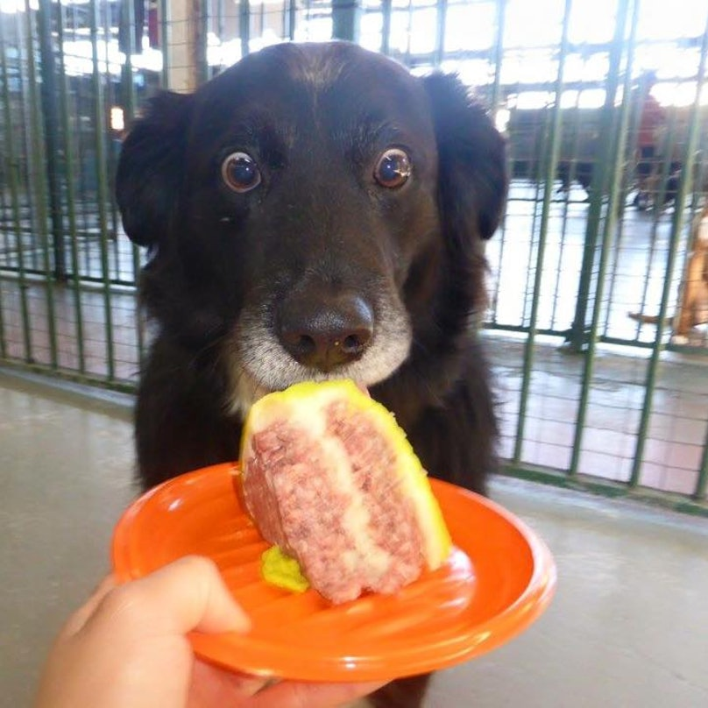
DevOps
In
Five…

Slide 3
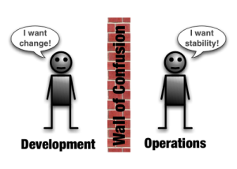
@smileandeliver
Notes:
Culture and Incentives are at odds with each other

Slide 4
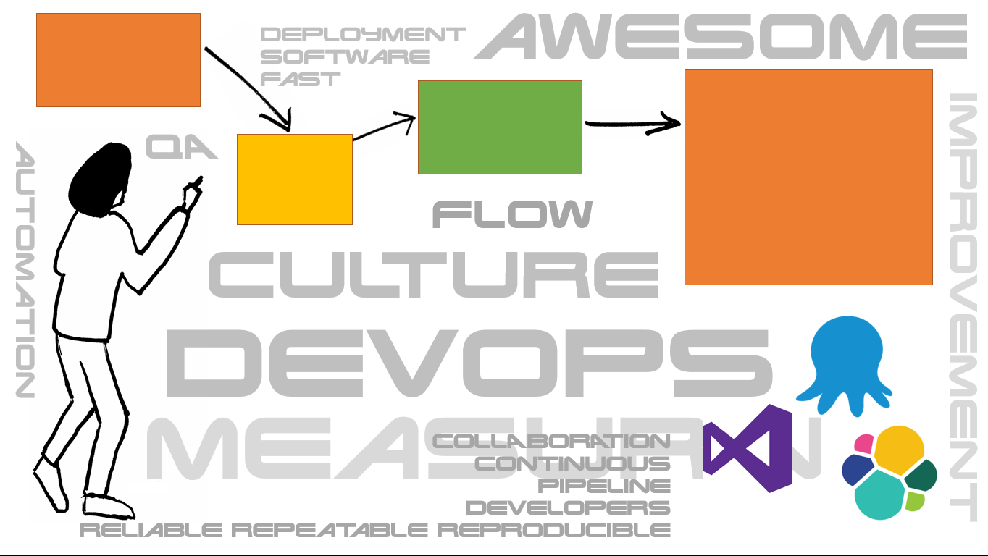
C
A
L
M
S
CULTURE
@smileandeliver

Slide 5


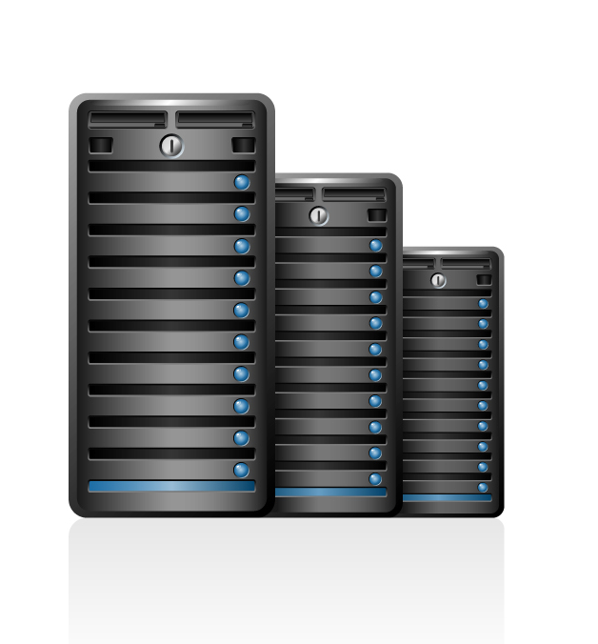



C
A
L
M
S
AUTOMATION
@smileandeliver

Slide 6
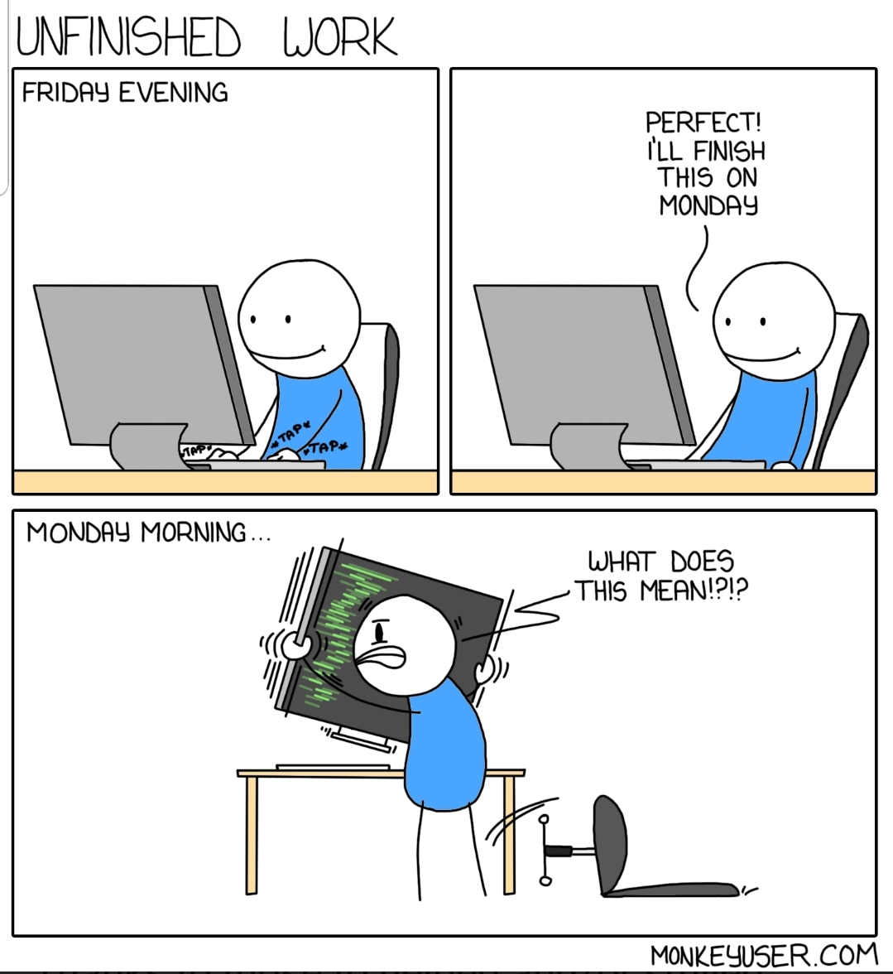
C
A
L
M
S
LEAN

Slide 7

C
A
L
M
S
MONITORING

Slide 8
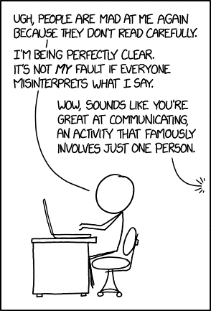
C
A
L
M
S
SHARING

Slide 9

“Testing Is DevOps”
@smileandeliver

Slide 10


Dev
Ops
Dev
Ops
Dev
Ops
@smileandeliver

Slide 11



Three Ways of DevOps
God
Reporter
Genius
@smileandeliver

Slide 12

Gods
The First Way
Systems Thinking
The Second Way
Reporters
Amplify Feedback Loops
The Third Way
Geniuses
Culture of continual experimentation and learning
@smileandeliver
Notes:
[This slide is animated ‘on click’ for the words Gods, Reporters, Geniuses to appear]
Time to split up into your three groups – Think about the ‘way’ that you have chosen; what ideas do you have – or what changes could you make in your organisation which will facilitate and promote your way.
In DevOps, you need all three of these for success! But right now, just go with yours
I will leave a video loop playing so that you can get a reminder of each ‘way’ and what it means, if you need it. Don’t be too tied down by these definitions – just write down any ideas for improvement as they occur to you.
(Direct participants to their flipcharts or whiteboards)
You have x minutes – please feel free to ask anything as you go

Slide 13

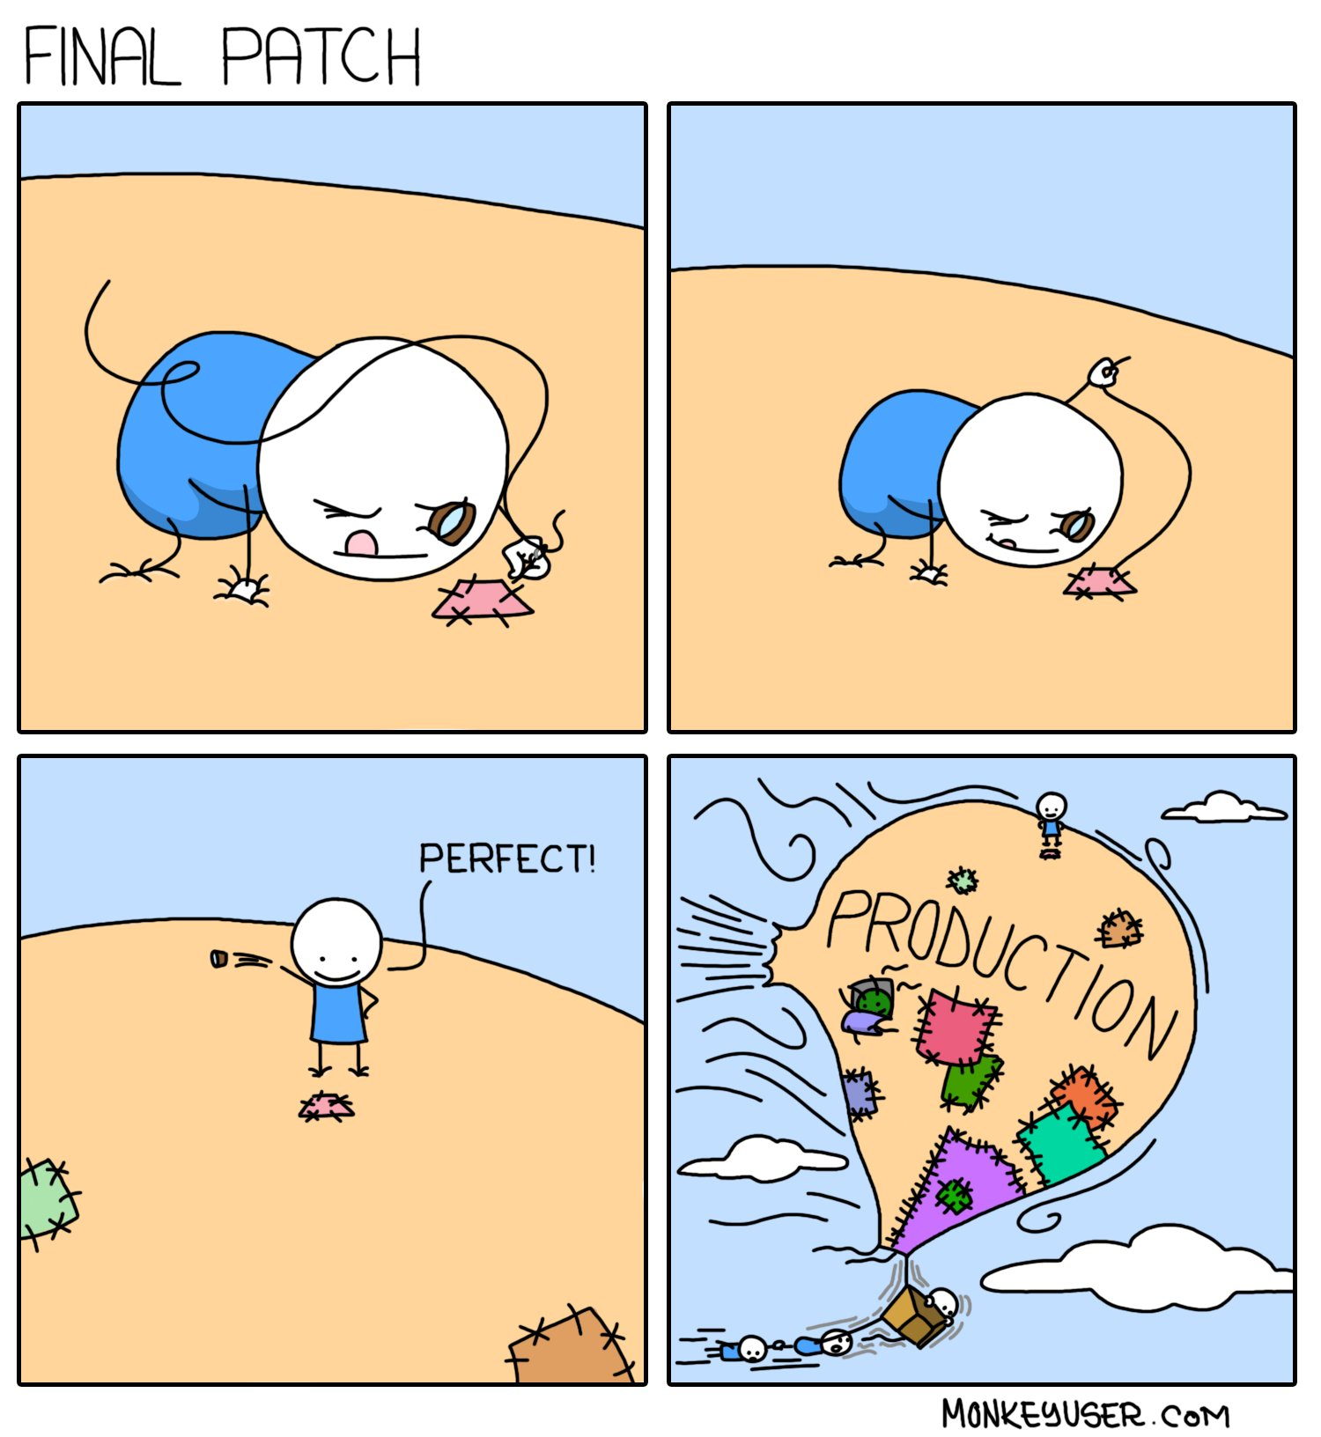
@smileandeliver
Notes:
Where we are going wrong. We can put out something that passes all its software and functional testing but which is a nightmare waiting to happen
We are doing DevDev Very Well – we’re even killing it at DevPlatform. But until we crack Operability, We do NOT have DevOps

Slide 14

We can have fantastic sales,
account management, innovative products,
good pricing,
fabulous marketing…
But if we don’t deliver the service
they will not come to us
and/or walk away
@smileandeliver

Slide 15
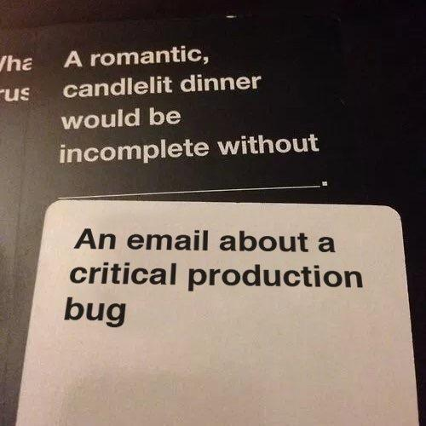
"Development" teams get something "working" then throw it to an "Operations" team who struggle to wrestle with the day-to-day running and support of it.
Software Scoped to Functional Reqs
No Resources once in Production
Deliverable ≠ Operable
@smileandeliver
Notes:
I've seen, on a number of occasions, "Development" teams get something "working" then throw it over the wall to an "Operations" team who then struggle to wrestle with the day-to-day running and support of it. Often, this has been because the requirements of the system/software have been so narrowly scoped to functional requirements (i.e. to get it doing what it needs to do so we can say it's done), that the non-functional and on-going, operational requirements (e.g. monitoring/support/upgrades/decommissioning/data retention/cleanup etc.) get overlooked and/or aren't considered.
"Application Lifecycle Management" anyone?
All the time/effort/money/resources gets put in at the start of a "project", then when something is delivered, all the resources get taken away leaving the operational side (without a budget and with a bit of a train-wreck of a system/solution to support). I've also seen this compounded by the assumption(s) that once something is built/released and in Production, that it's "done"/"working"/"delivering" and doesn't...
cost any more people/time/resource/money to support
will never have any problems

Slide 16
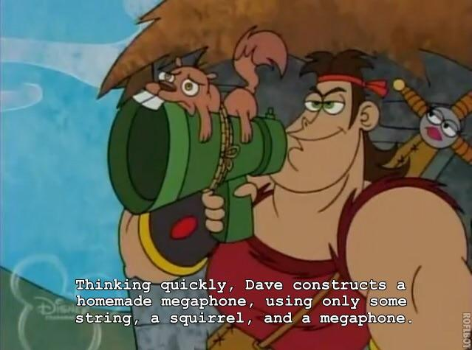
Complexity:
One of the greatest enemies of Operability
@smileandeliver
Notes:
Have we delivered the Requirements in the most efficient way? Is there a complicated and error prone switch we have to do in order to switch between live environments? Does a change in config require disruptive restarts? Do you have to do stuff manually?

Slide 17
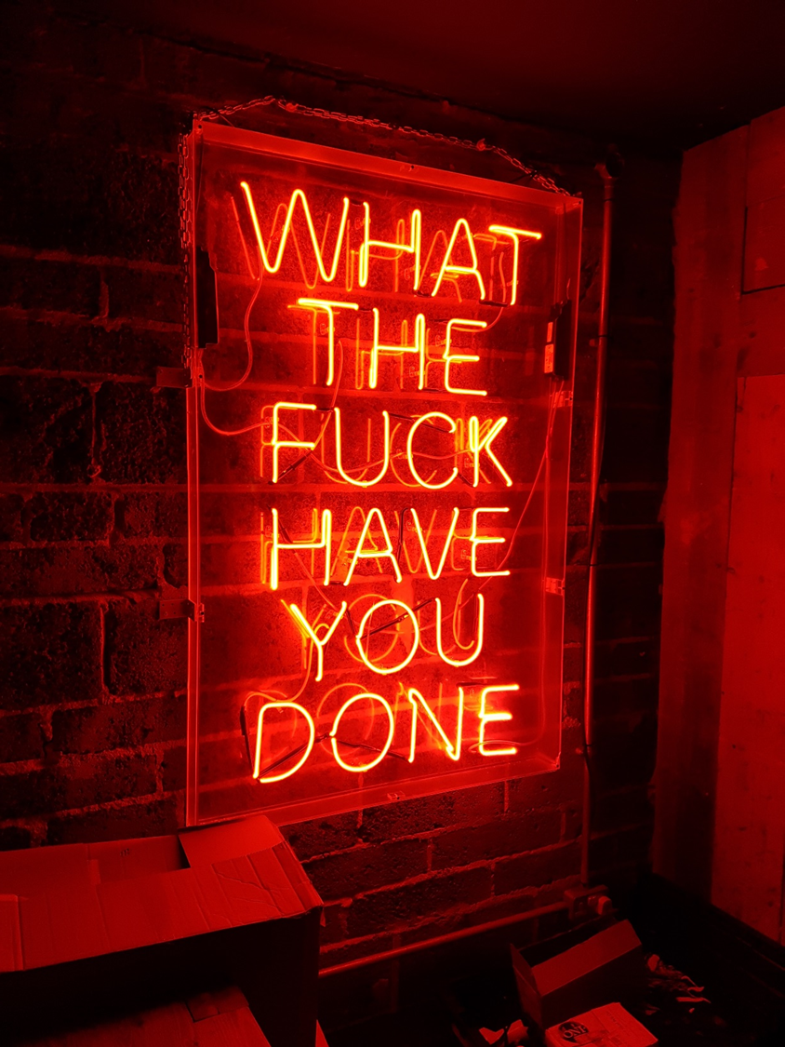
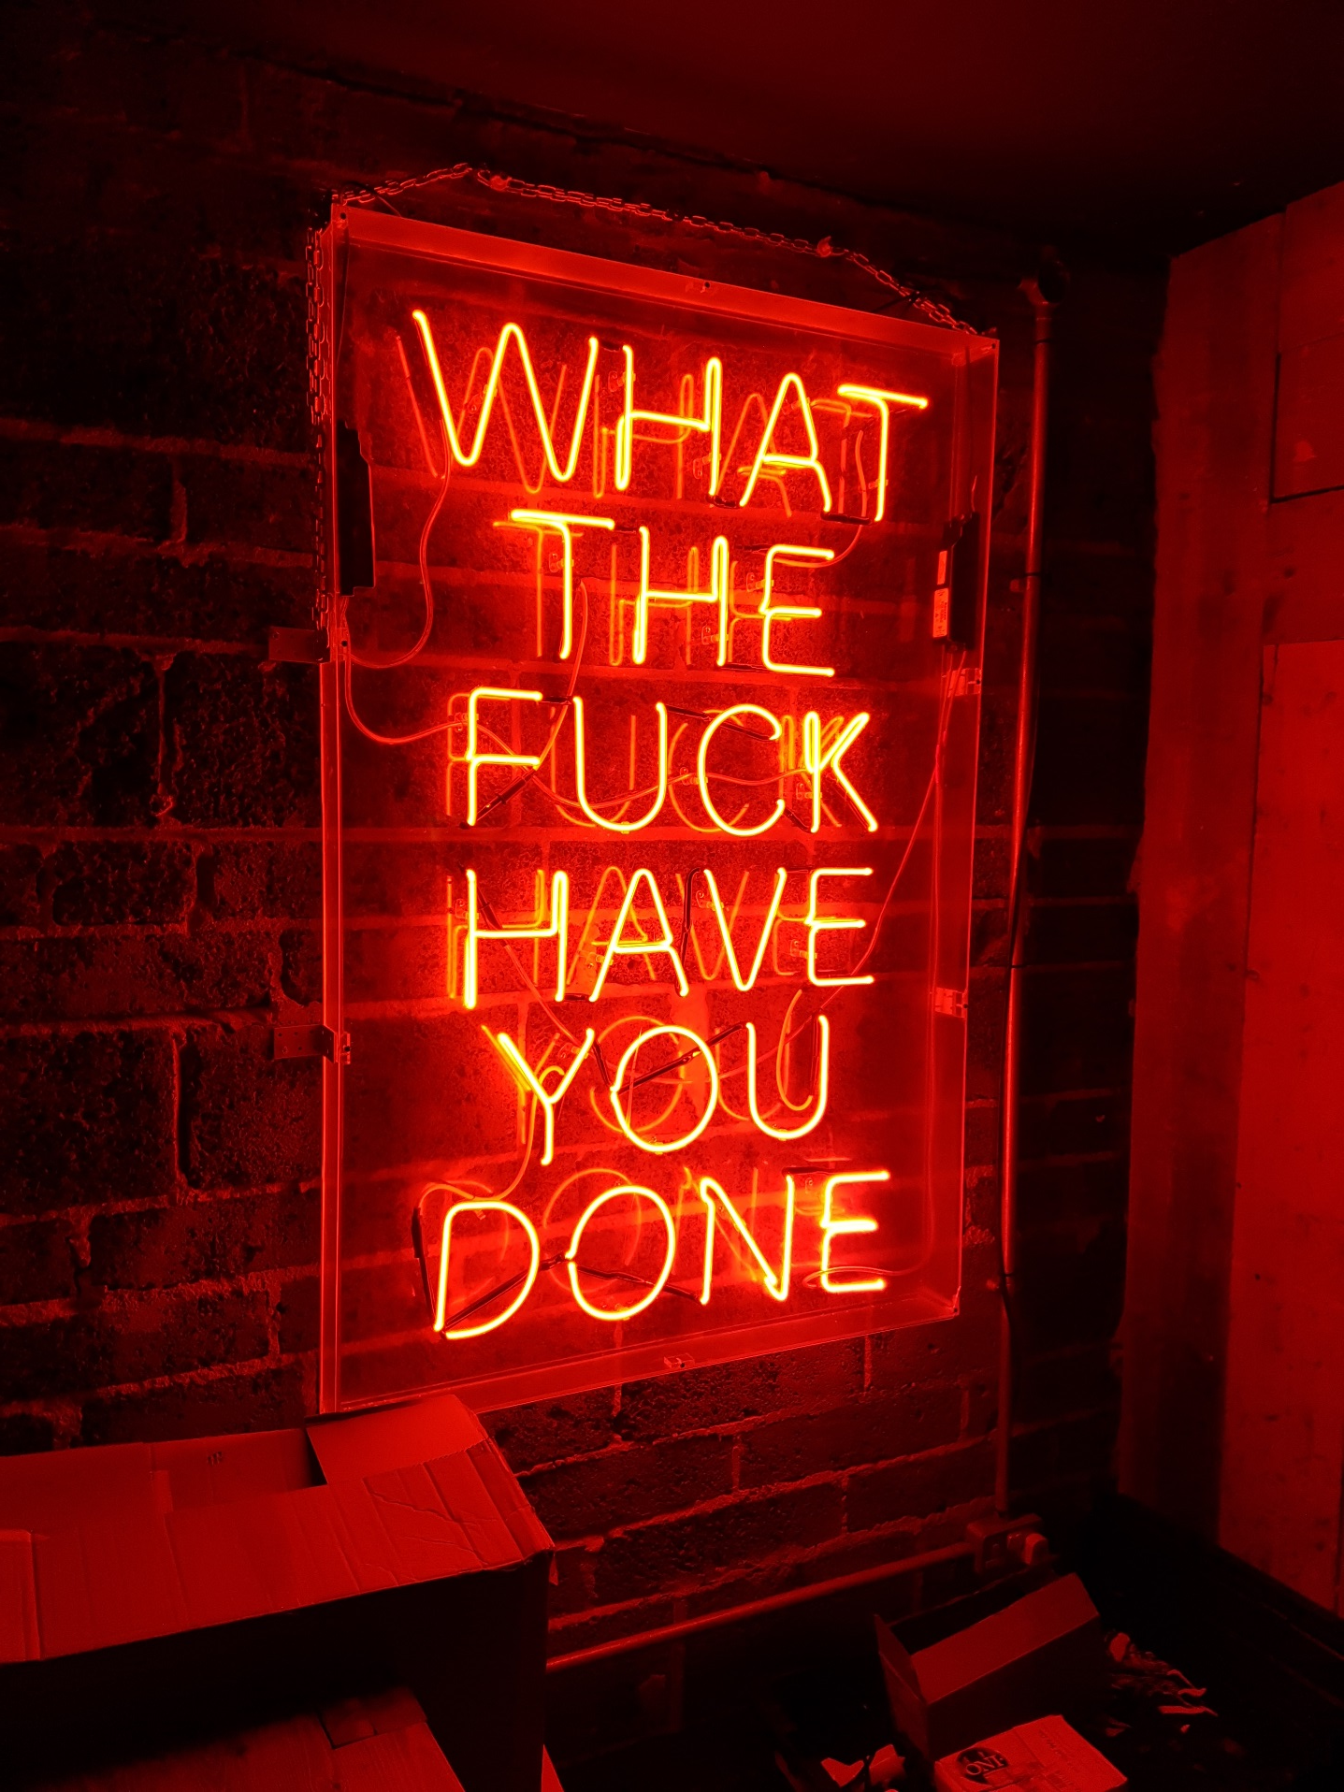
….
….
@smileandeliver
Notes:
Metrics – are they telling you what the fuck is going on ? Do you have the information that says exactly what just happened? Are the environments so sterile that your tests in preprod are gonna be truly representative of Prod so that you can troubleshoot without touching Live?

Slide 18
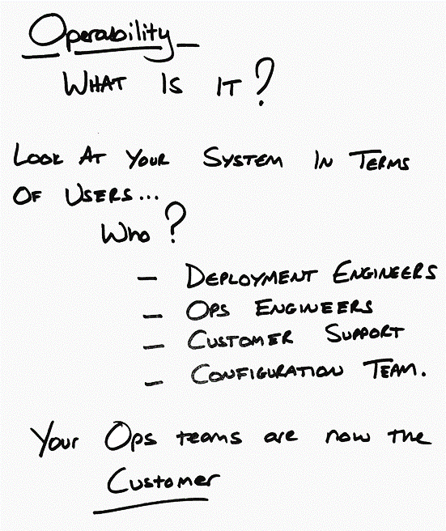
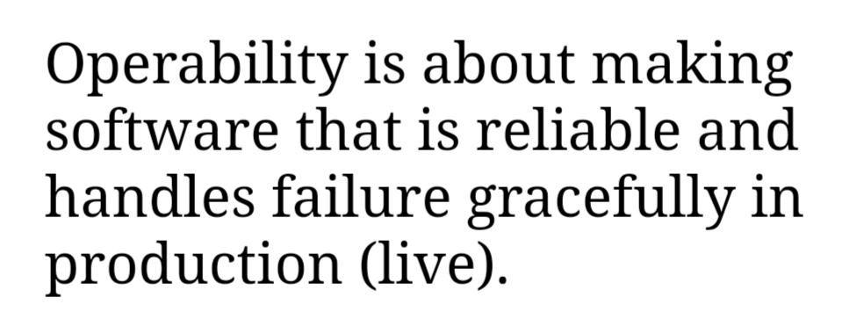
@smileandeliver

Slide 19
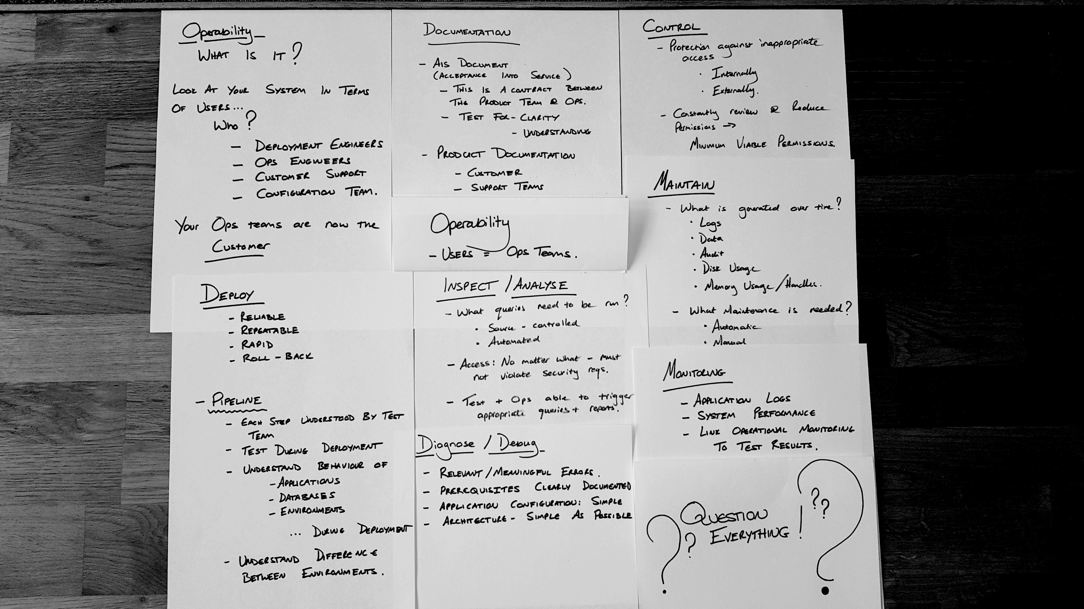

Slide 20

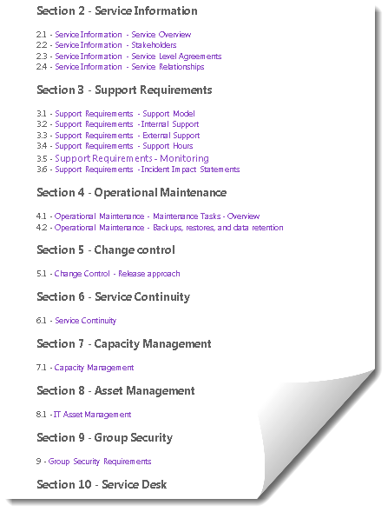
Operability Documentation
AIS DOCUMENT
(Acceptance into Service)
Operability Contract between All teams
Clarity
Understanding
Completeness
PRODUCT DOCUMENTATION
Customer Facing
Support
Architecture
Notes:
· Recovery Time Objective (RTO)
· Recovery Point Objective (RPO)
· Minimum Recovery Operating Level (MROL)

Slide 21
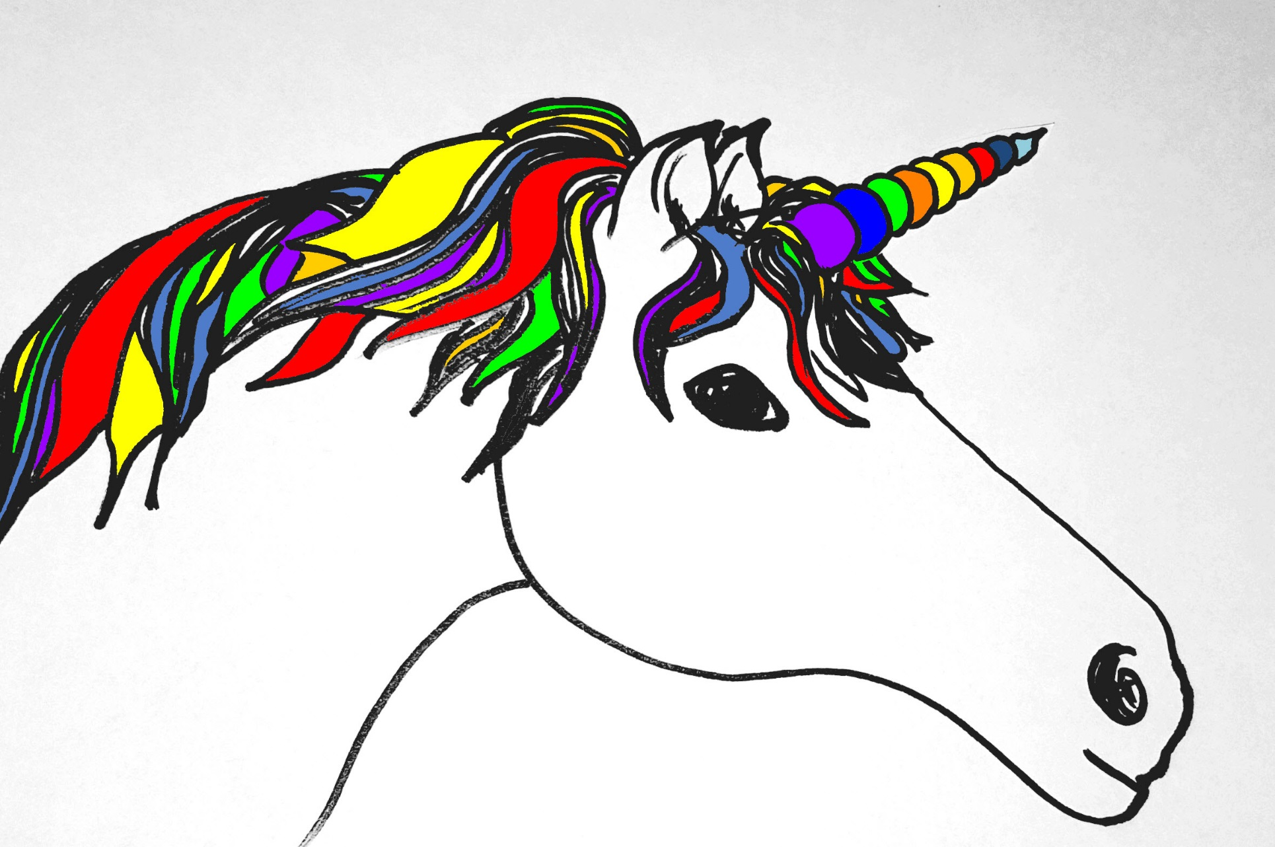

Deployability
Reliable
Repeatable
Rapid
Roll-back
PIPELINES
Each step understood
Applications / Services
Databases
Environments
Walking Skeleton
Test During Deployment

Slide 22

Maintainability
What builds up over time?
Logs
Data
Audit
Memory Usage
What Maintenance is Needed?
Automatic
Manual
@smileandeliver

Slide 23
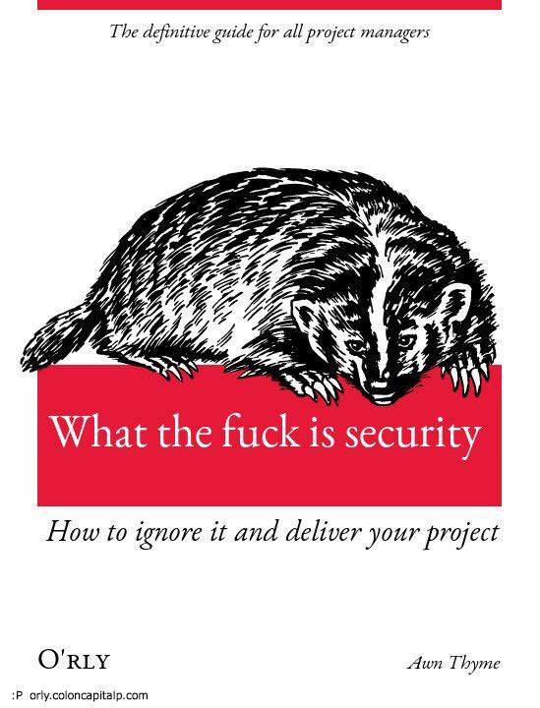
Control
Protection against inappropriate access
Internally
Externally
Regularly Review and Reduce Permissions
Minimum Viable Permissions
Access via Controlled System
Access Audit

Slide 24

Monitoring
Application Logs
System Performance
Link Ops Monitoring to Test Results
Inspect/Analyse
What queries need to be run?
Source-Controlled
Automated
Access: Must comply with Security Reqs
Test & Ops Teams able to trigger Appropriate Queries & Reports
Diagnose/Debug
Relevant / Meaningful Errors
Prerequisites Clearly Documented
Simple:
Application Configuration
Architecture
@smileandeliver

Slide 25
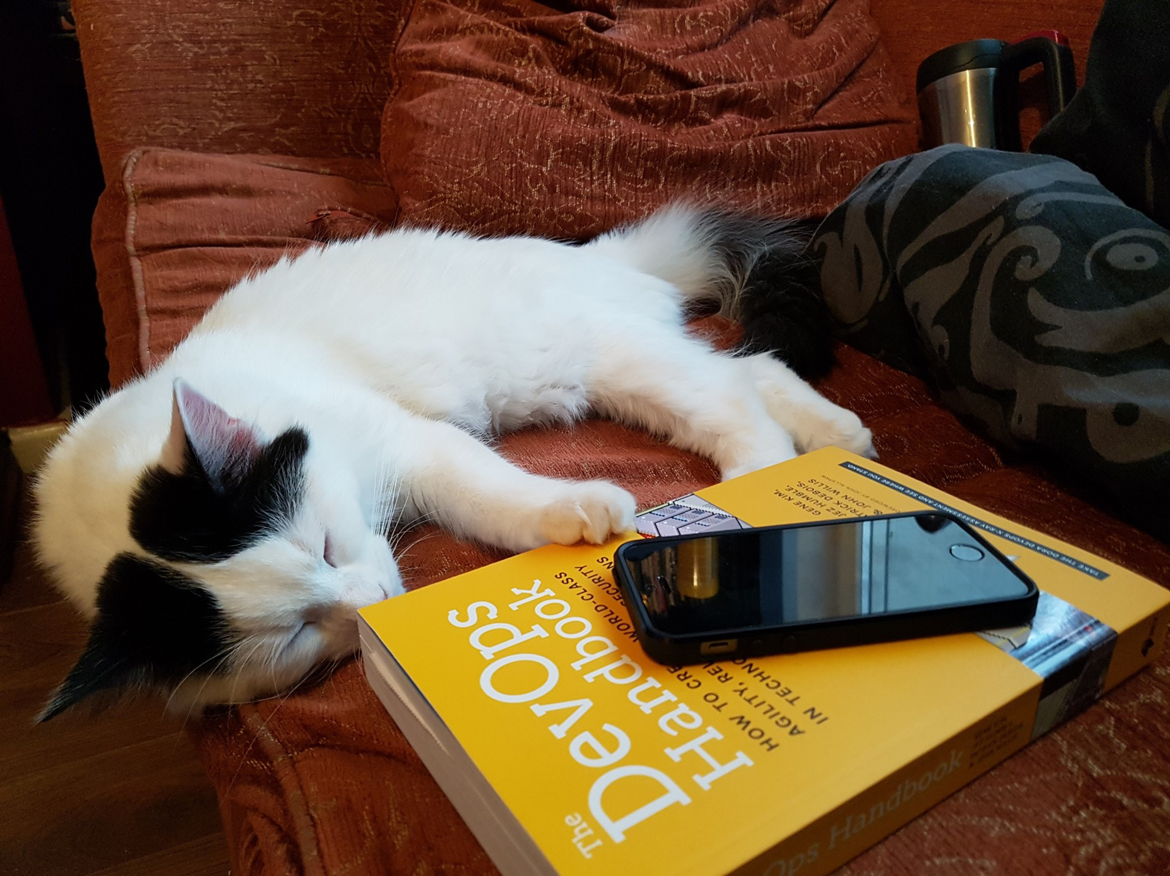
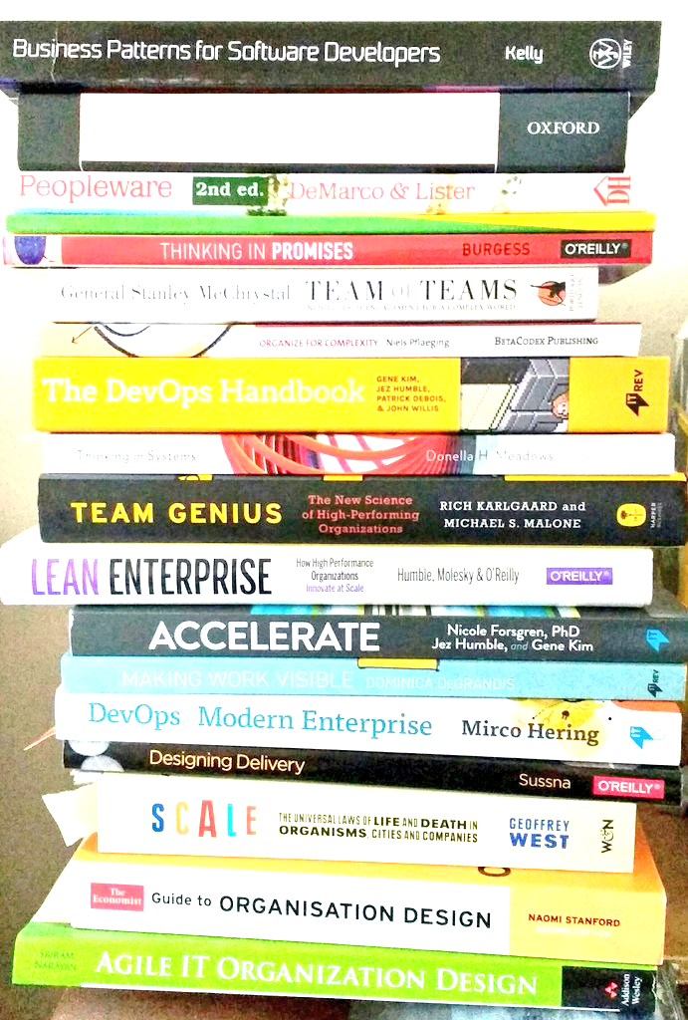
@smileandeliver
Notes:
Insert credits here particularly Continuous Delivery, DevOps Handbook, Phoenix Project and Software Operability Manuel Pais and Matthew Skelton

Slide 26

Header
@smileandeliver
https://github.com/smileandeliver/
Notes:
Thank you and please come forward with any questions

Slide 27


@smileandeliver

Slide 28


